Slide 1
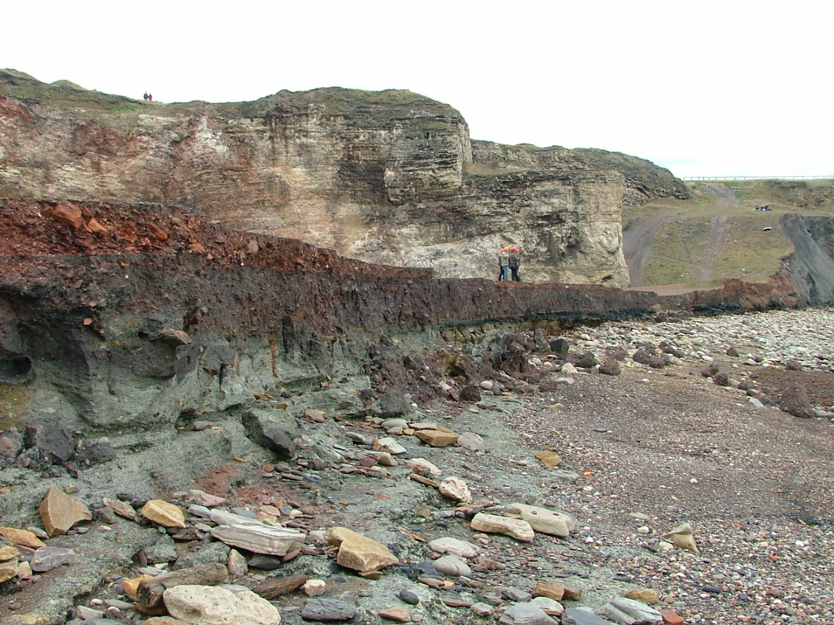
SEASCAPES
READING THE ROCKS
David Roberts
Durham University
Info boards/leaflets
at Gateways/Heritage Centres
Online resources:
animated story + key rocky themes
Events/
Guided walks

Slide 2
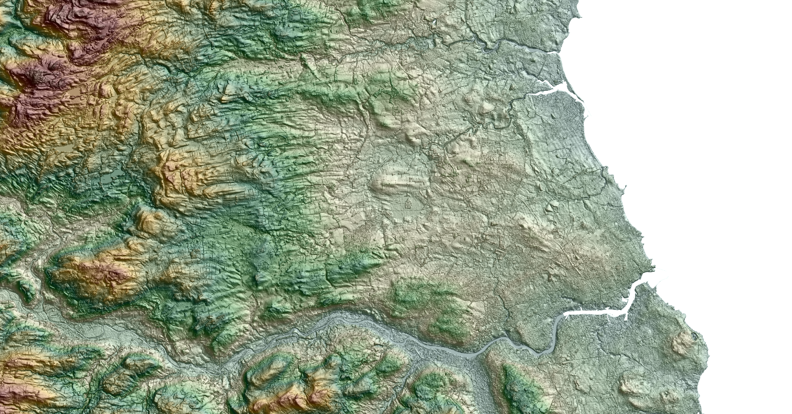
SeaScapes
Reading the Rocks
A draft story board
David Roberts
Durham University
©David Roberts/Stephen Livingstone

Slide 3
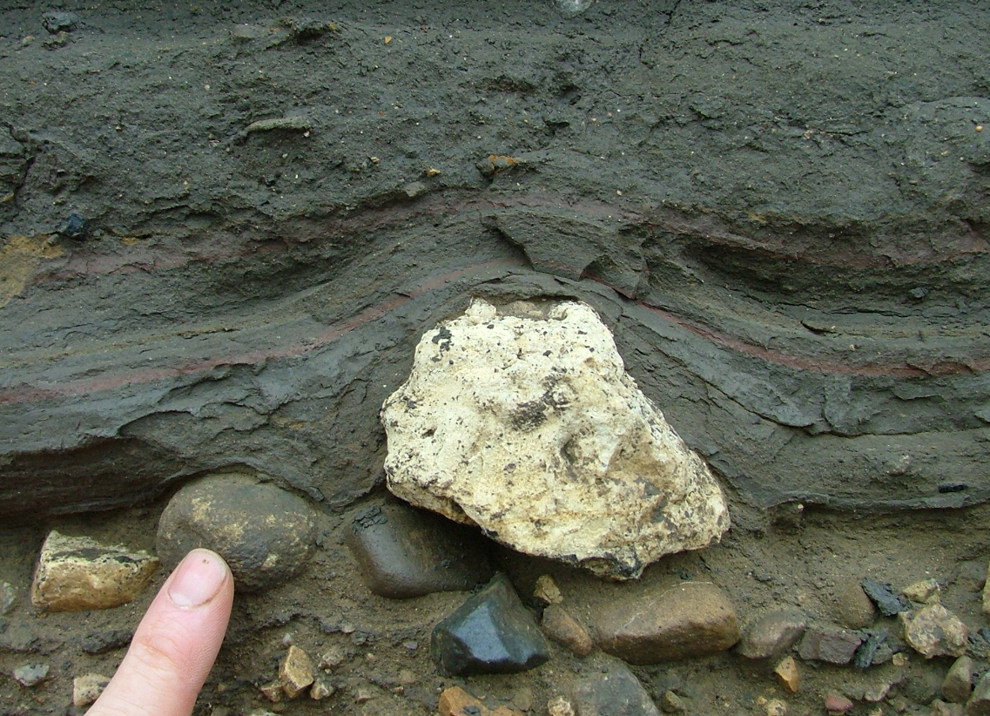
SeaScapes
Reading the Rocks
A draft story broad
Key themes for Reading the Rocks:
Our landscape
The Foundations of our landscape
    The Carboniferous and Permian Bedrock
    The Quaternary: The ice age mud on the top!
    The mixed, rocky shoreline
The Ice Age
    Ice sheets and ice stream footprints
    Our hidden offshore world
    The lakes and the Denes
Our industrial legacy
Turning the world upside down
The film sets
5. Exploring
©David Roberts
Secret dropstones - a gift from the ice (Seaham)

Slide 4
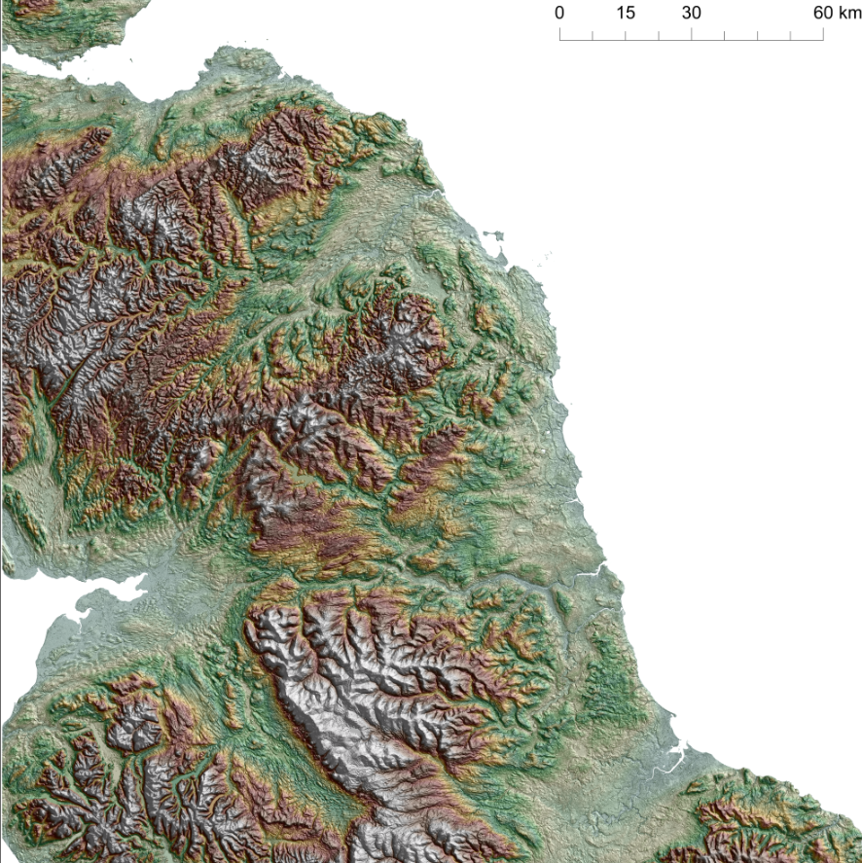
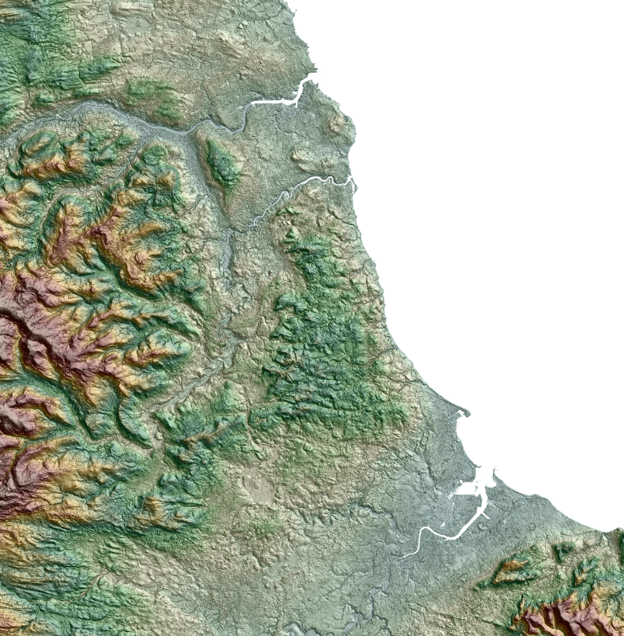
SeaScapes
Reading the Rocks
A draft story broad
1. Our landscape
Tyne to Tees: the Big picture
The Cheviots, Pennines and North York Moors
The Tyne, Wear and Tees river corridors
The coastal strip
  The Tyne and Tees lowlands bounding the Durham coastal plateau
  The coastal interface
©David Roberts
©David Roberts/Stephen Livingstone
©David Roberts/Stephen Livingstone

Slide 5
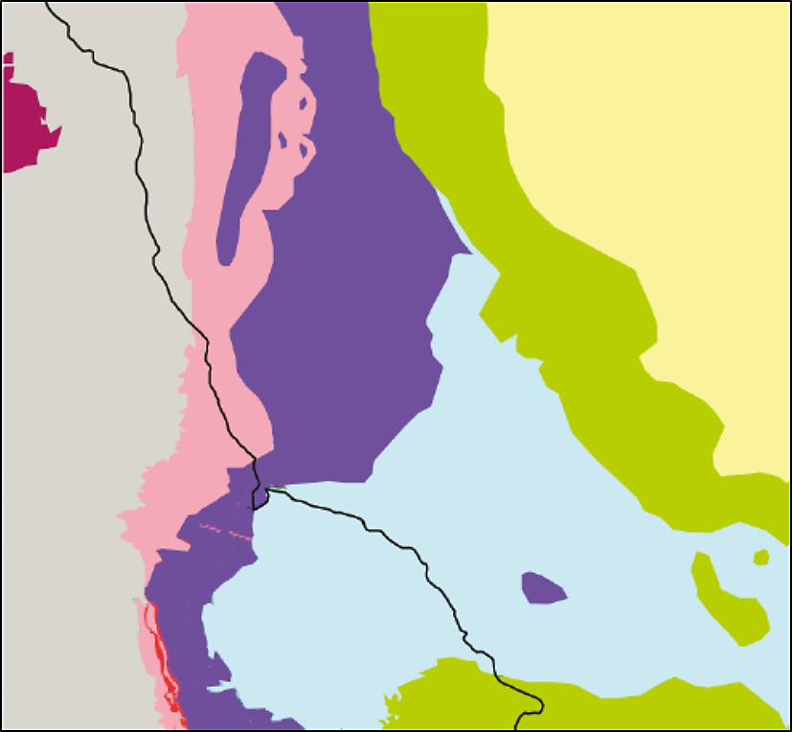
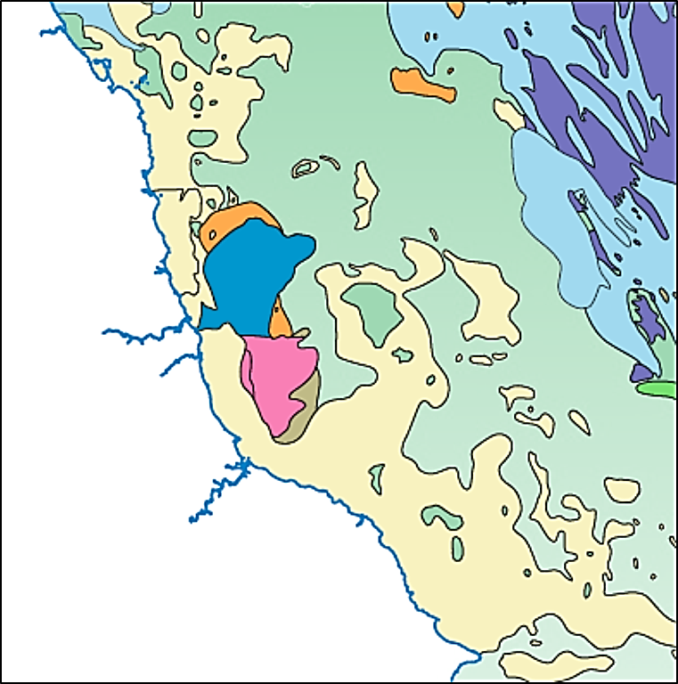
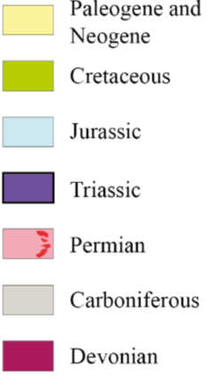
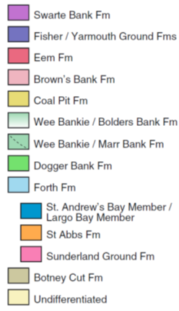
2. The Foundations of our landscape
The Carboniferous and Permian bedrock
The Quaternary: The ice age mud on the top
SeaScapes
Reading the Rocks
A draft story broad
Newcastle
Sunderland
Middlesborough
©David Roberts
©David Roberts
Three main bedrock types
Carboniferous to the north
Permian through the middle
Triassic to the south
The Ice age mud on the top
Thick sequences of ice sheet deposits along the coast
However, no ice age deposits immediately offshore because they are scoured-out.
Beyond 15km offshore the ice age sediments begin to thicken eastward

Slide 6
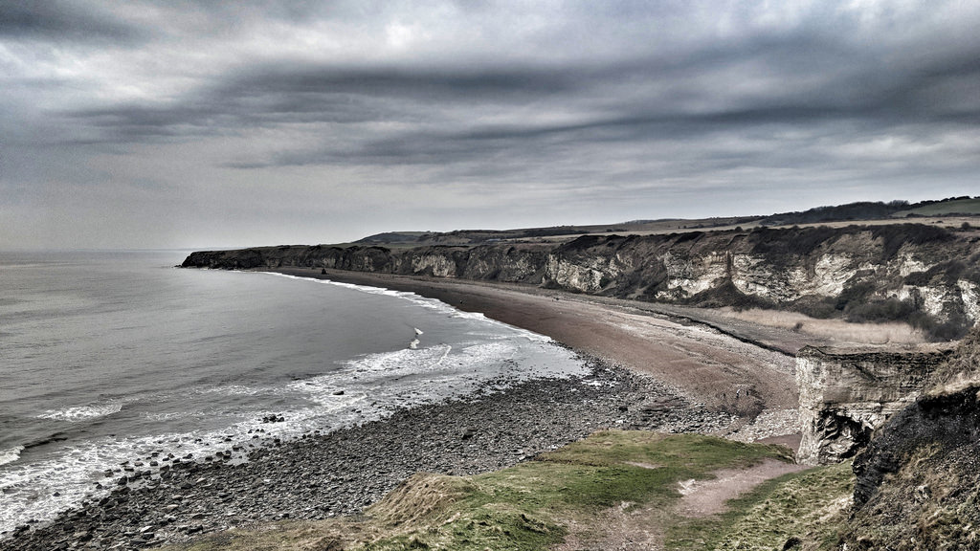
2. The Foundations of our landscape
The Magnesian Limestone
  The spectacular cliffs of County Durham are world famous for buried aeolian dunes, tropical seas (Zechstein Sea), evaporites, turbitides collapse breccias and fossils. Multiple sites of interest and SSSI’s along the coast.
  The limestone provides the foundations for unique grassland habitats.
SeaScapes
Reading the Rocks
A draft story broad
https://hiveminer.com/Tags/cliffs%2Cseaham

Slide 7
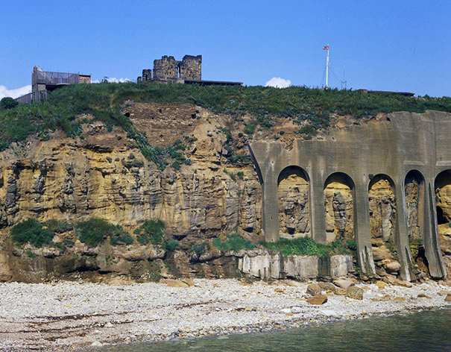
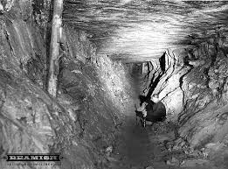
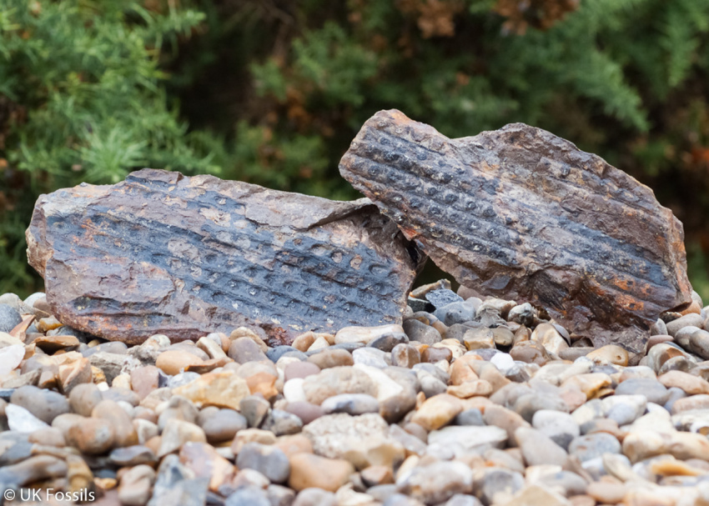
SeaScapes
Reading the Rocks
A draft story broad
2. The Foundations of our landscape
The Carboniferous
Most of the Durham coast is dominated by Permian rocks (mainly visible above sea-level), but to the north around the Tyne the Carboniferous rocks outcrop, and of course they underlie the whole of our region and have played a critical role in the evolution of our natural and cultural landscape (coal!)
Carboniferous exposures: Tynemouth Priory/headland - active coastal erosion, rockfall and landsliding.
The Knack Pit, Seaham colliery. Most of the rockwaste from the pits along the Durham coast got dumped on the beaches.
Carboniferous rocks and fossils litter the Durham beaches having been transported by ice and dumped by mining activity.
©BGS

Slide 8
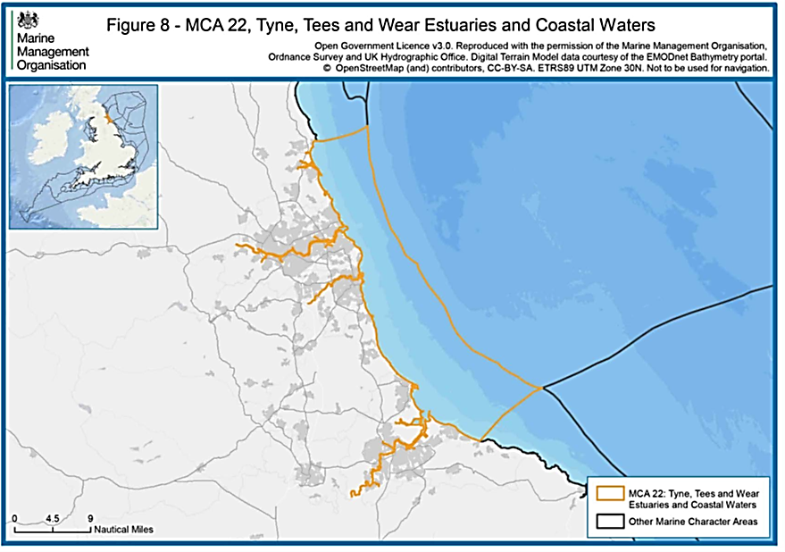
SeaScapes
Reading the Rocks
A draft story broad
2. The Foundations of our landscape
Mixed, rocky shoreline
Blyth
© Marine Management Organisation 2018
Newcastle
Much off the near shore areas offshore between the Tyne and Tees are situated in MCA 22.
This is a mixed rocky shoreline with Carboniferous and Permian rocks outcropping along the cliffs, in the intertidal zone and sub-tidally on the seabed.
Middlesborough
©David Roberts/Elena Grimoldi

Slide 9
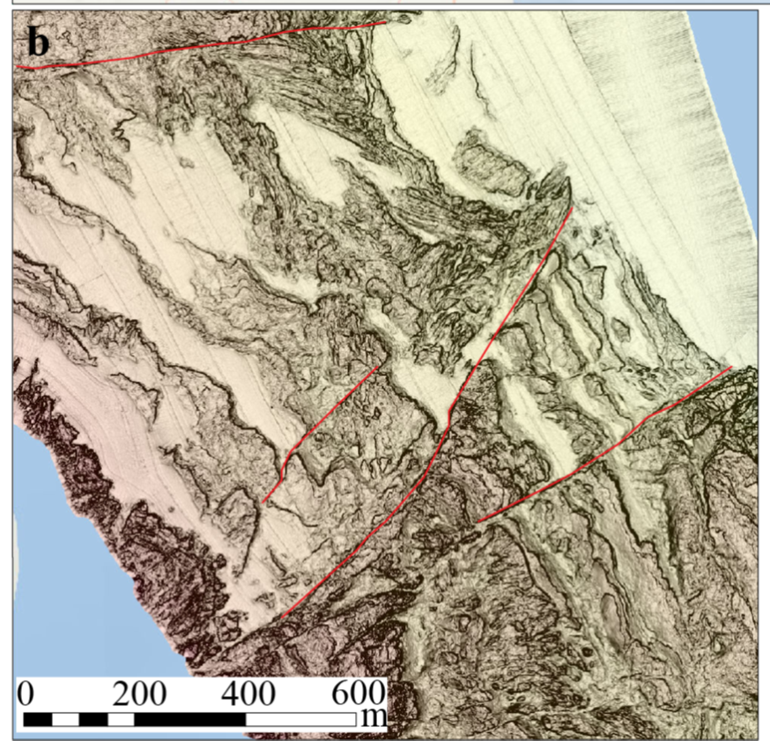
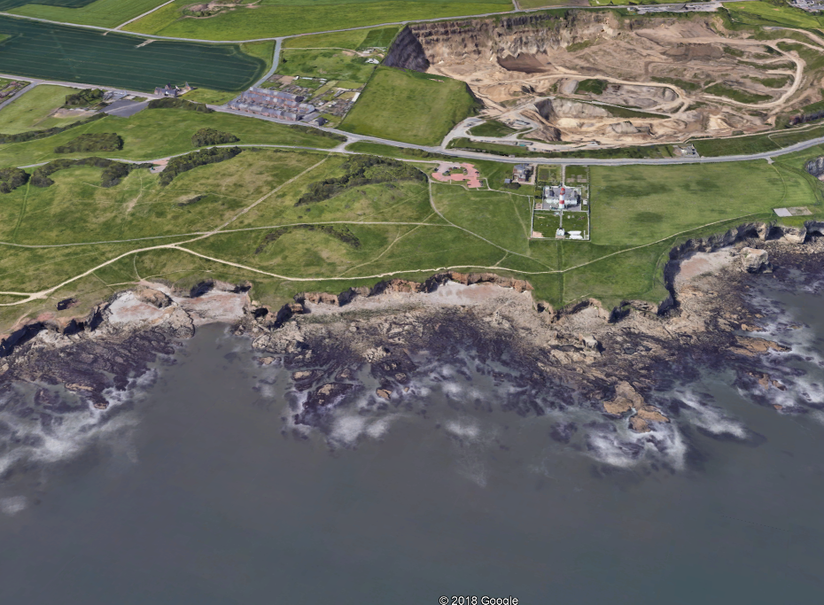
SeaScapes
Reading the Rocks
A draft story broad
2. The Foundations of our landscape
Mixed, rocky tidal and subtidal environments are critical for habitat development, fisheries and recreation.
©David Roberts/Elena Grimoldi
The Carboniferous ‘Reef’ - the rocky seafloor (Blyth)
Mixed, rocky shoreline - Permian Mag Limestone (Souter)

Slide 10
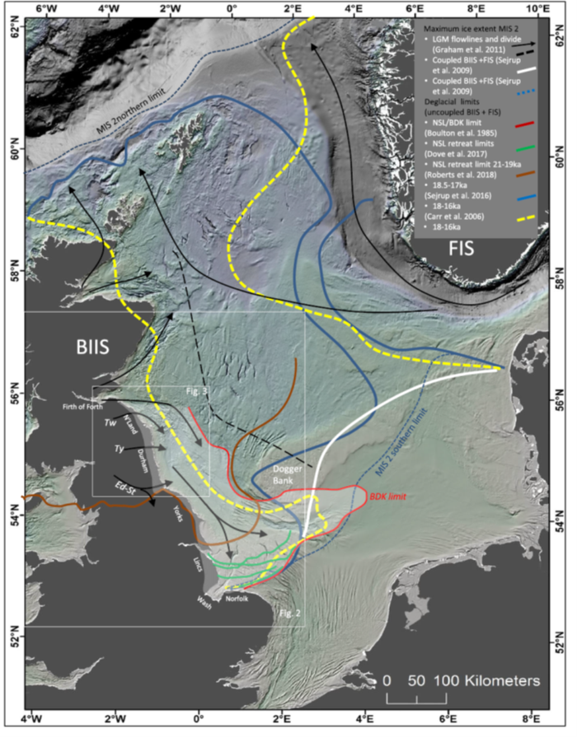
SeaScapes
Reading the Rocks
A draft story broad
3. The Ice Age
    The Last Ice sheets
The Last Ice Age
26,000 to 11,500 yrs ago in the UK
Ice in County Durham and offshore was fed initially by an ice stream flowing through the Tyne Gap and later by ice flowing south down the coast fed by the Tweed and Firth of Forth Ice Streams.
Ice left County Durham between 19, 600 and 17,000 yrs ago.
Along the coast as ice receded north it was fringed by rivers and large lakes as water became trapped between the ice and the high ground.
These lakes, such as Glacial lake Wear and Tees, probably cut the Durham Denes as they over-spilled when the ice dams along the coast broke.
Patton et al., 2017
Roberts et al., 2018

Slide 11
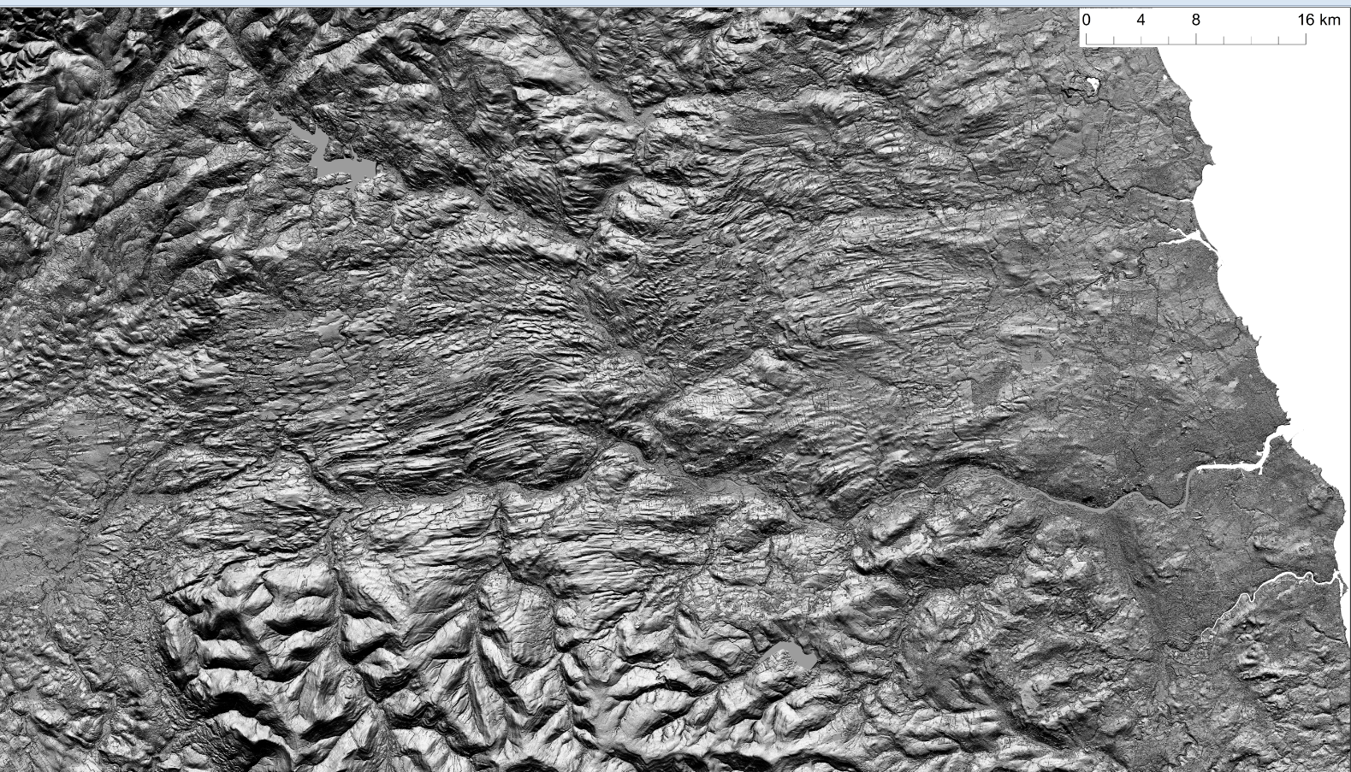
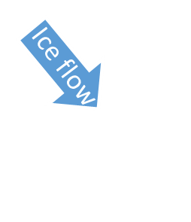
SeaScapes
Reading the Rocks
A draft story broad
3. The Ice Age
Ice stream Footprints – The Tyne Gap ice stream imprint
©David Roberts/Stephen Livingstone

Slide 12
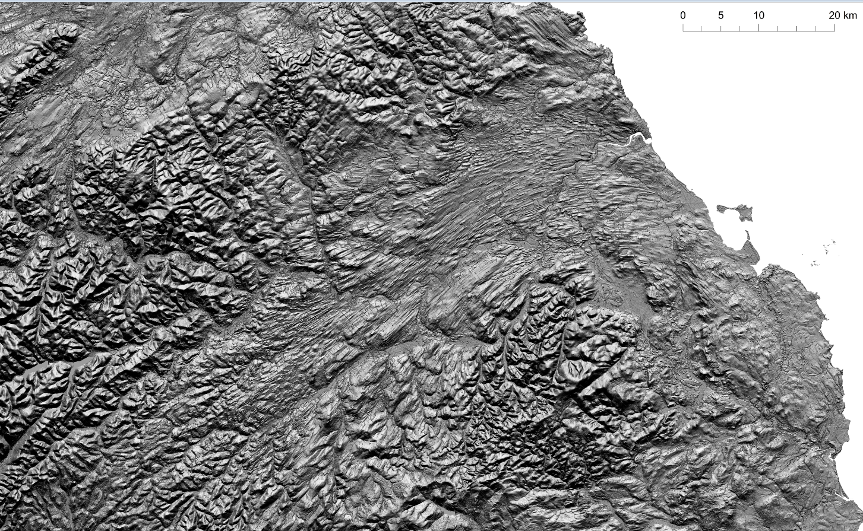
3. The Ice Age
Ice stream Footprints – The Tweed ice stream imprint
SeaScapes
Reading the Rocks
A draft story broad
©David Roberts/Stephen Livingstone

Slide 13
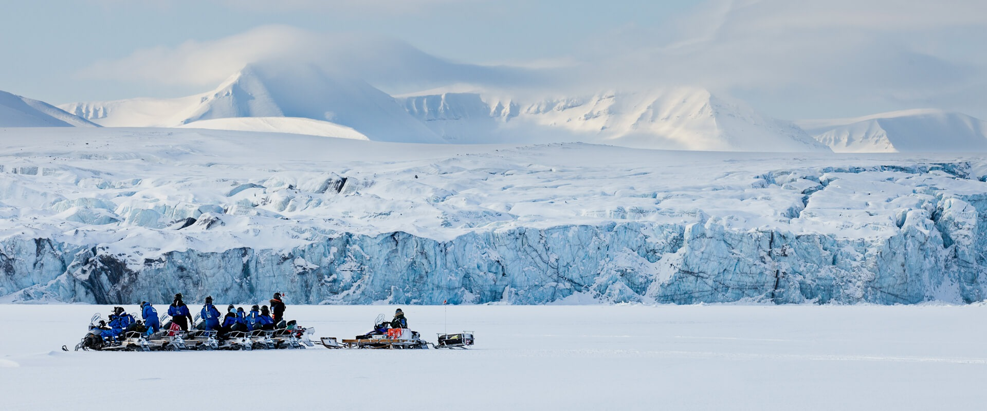
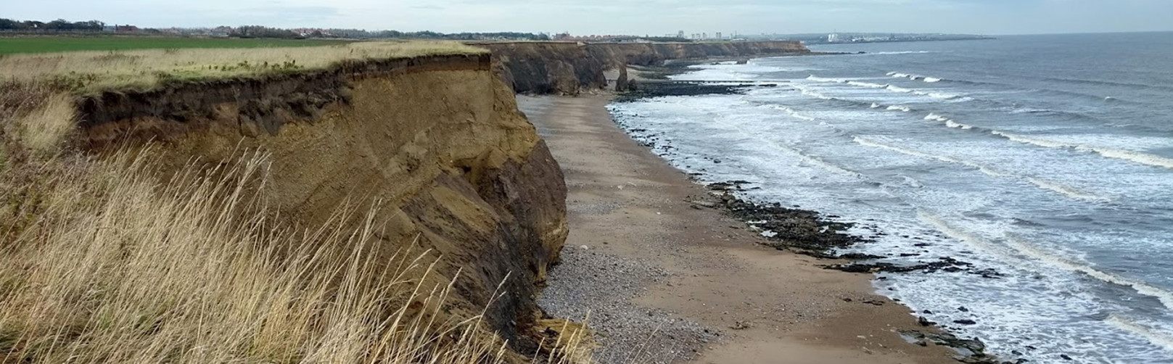
SeaScapes
Reading the Rocks
A draft story broad
3. The Ice Age
Ice stream Footprints – All along the coast we see the sediments left by the ice streams
25,000yrs BP
The Durham Coast
Today
©David Roberts

Slide 14
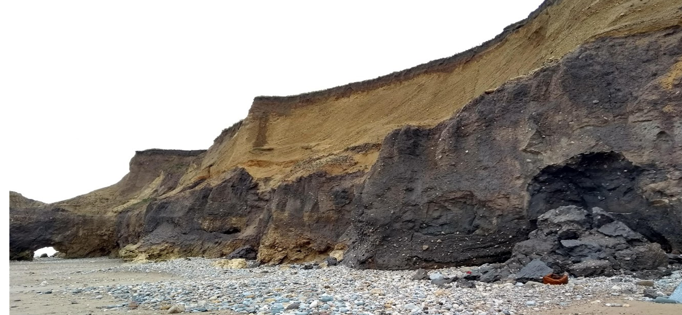
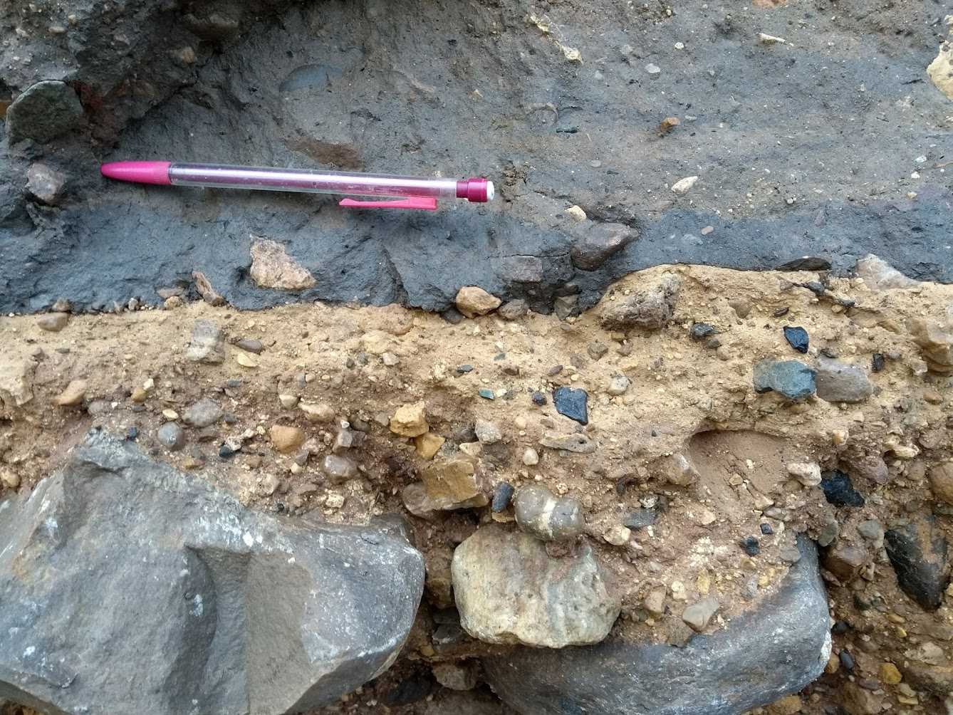
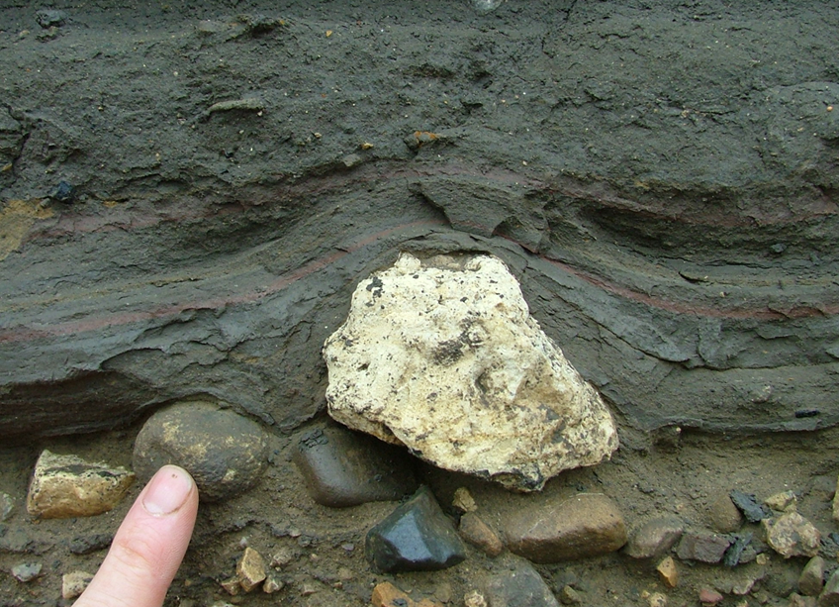
3. The Ice Age
Ice stream Footprints – All along the coast we see the sediments left by the ice streams
Multiple sites of ice sheet history
  E.g. Whitburn, Seaham, Warren House Gill
SeaScapes
Reading the Rocks
A draft story broad
Subglacial sediments
deposited by the ice
Lake sediments from
Glacial lake Wear
©David Roberts
Bedrock - deformed and crushed by the ice
Dropstones dropped by the ice

Slide 15
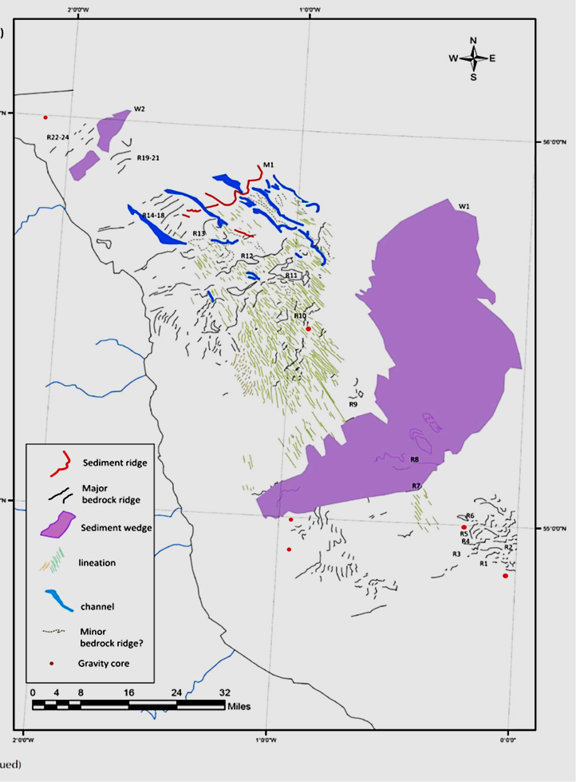
3. The Ice Age
Our hidden ice age world offshore
SeaScapes
Reading the Rocks
A draft story broad
The Last Ice Age
Offshore from County Durham the imprint of the final phase of glaciation can be seen on the seafloor.
This is often referred to as the ‘North Sea Lobe’ and was fed by Scottish ice from the Firth of Forth Ice Stream.
There are streamlined bedforms (drumlins and MSGL) as well as meltwater channels cut into the bedrock.
As the ice receded up the Durham coast, the sea flooded in between 19,000 – 16,000 yrs ago
Ice flow
Ice flow
Blyth
Newcastle
Middlesborough
©David Roberts/Elena Grimoldi

Slide 16
3. The Ice Age
Our hidden ice age world offshore
SeaScapes
Reading the Rocks
A draft story broad
Streamlined bedforms (drumlins and MSGL) indicating ice streaming across the seafloor (offshore Northumberland)
Ice flow
©David Roberts/Heather Stewart/British Geol Survey

Slide 17
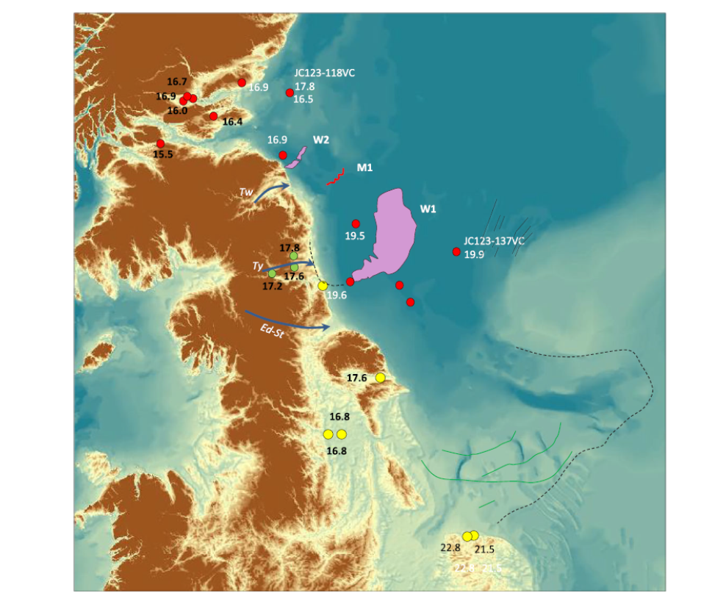
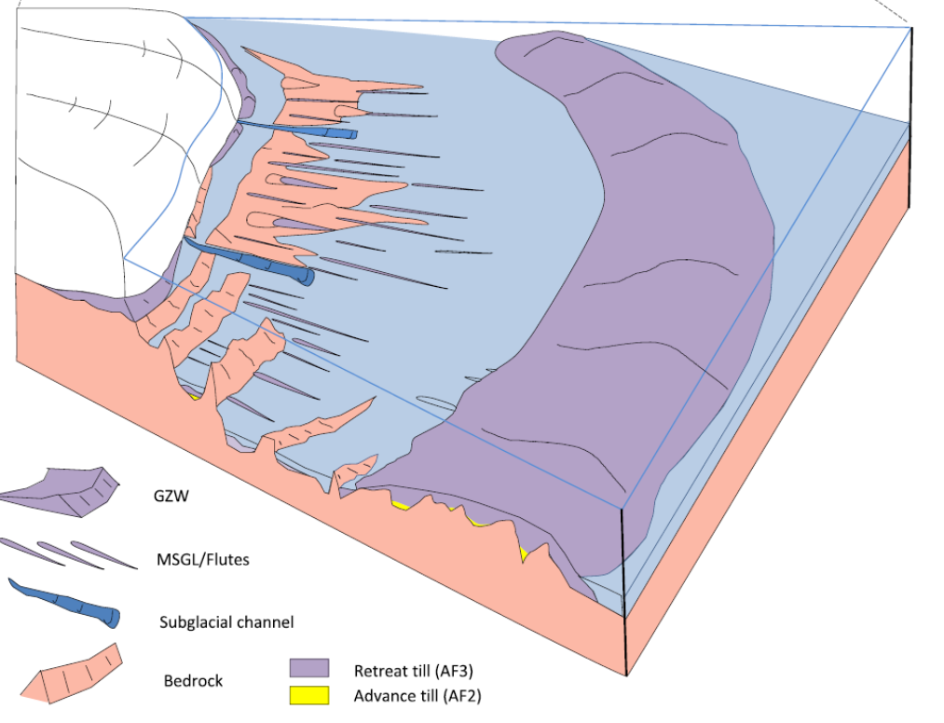
SeaScapes
Reading the Rocks
A draft story broad
3. The Ice Age
Our hidden ice age world offshore
Roberts et al., 2018
Roberts et al., 2018
A reconstruction of the last ice sheet as it receded north from the Durham coast between 19,000 – 16,000yrs BP

Slide 18
3. The Ice Age
Our hidden ice age world offshore
SeaScapes
Reading the Rocks
A draft story broad
All across the seabed offshore there is a clear record of the ice disappearing and the sea flooding in between 19,000 – 16,000 yrs ago.
This is shown by the transition from subglacial sediments to glaciomarine sediments
Eventually fully marine conditions were re-established offshore and throughout the Holocene (the last 10,000ys) our coastline began to take the form we see today.
Marine = marine conditions
Glaciomarine = ice retreating as the sea floods in
Subglacial = under the ice
©David Roberts

Slide 19
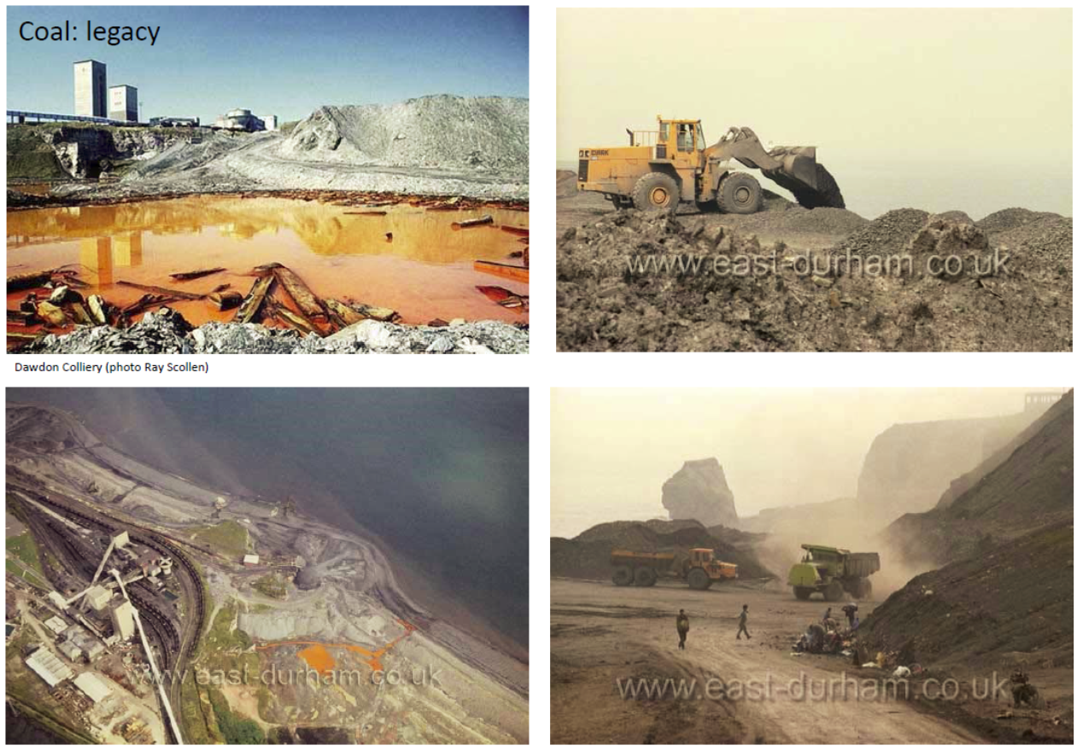
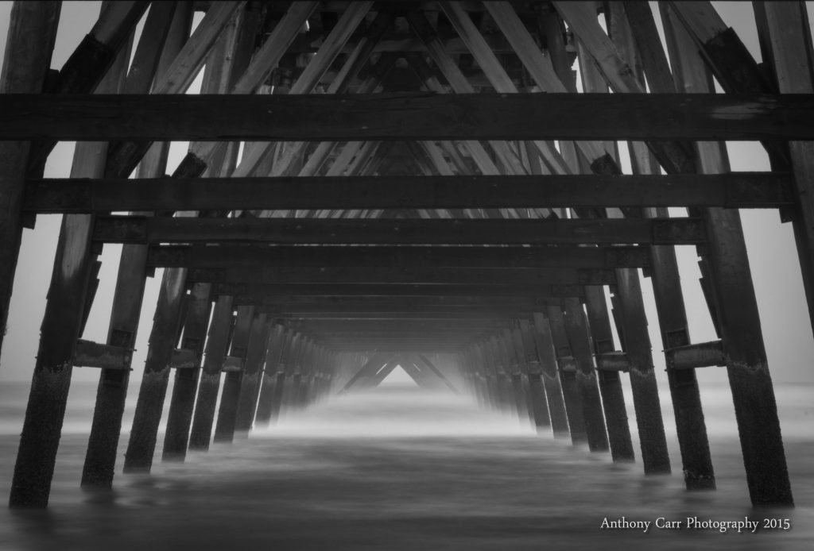
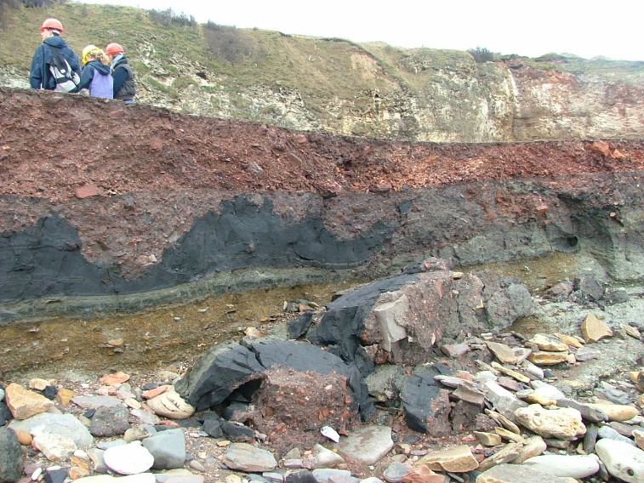
SeaScapes
Reading the Rocks
A draft story broad
4. Our industrial legacy
Turning the world upside down
The legacy of coal mining on the Durham coast and its impacts on people, culture, infrastructure and environment is almost immeasurable.
Other wonders, such as the Steettley Pier, are lasting legacies of now defunct industries.
Multiple sites of geological/cultural/environmental interest.
©David Roberts

Slide 20
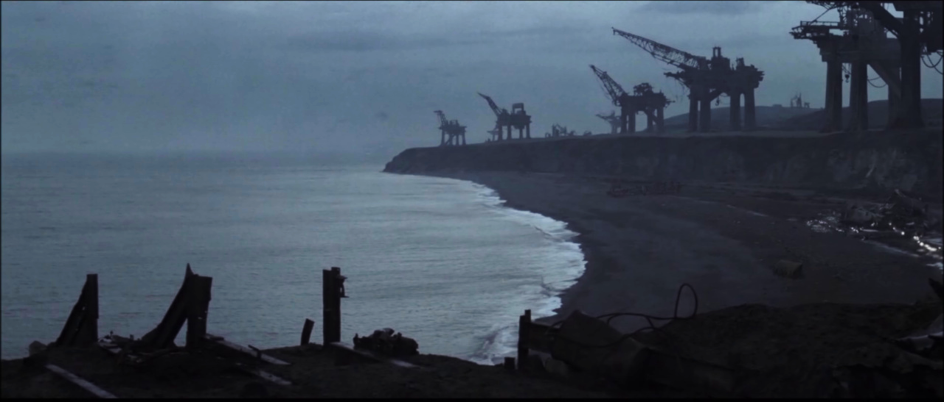
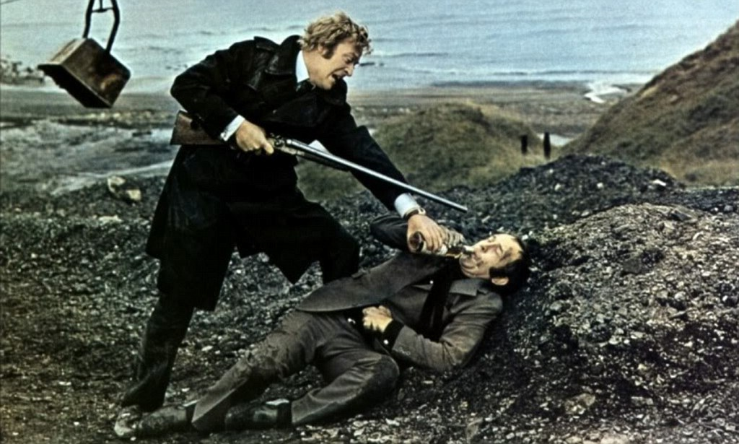
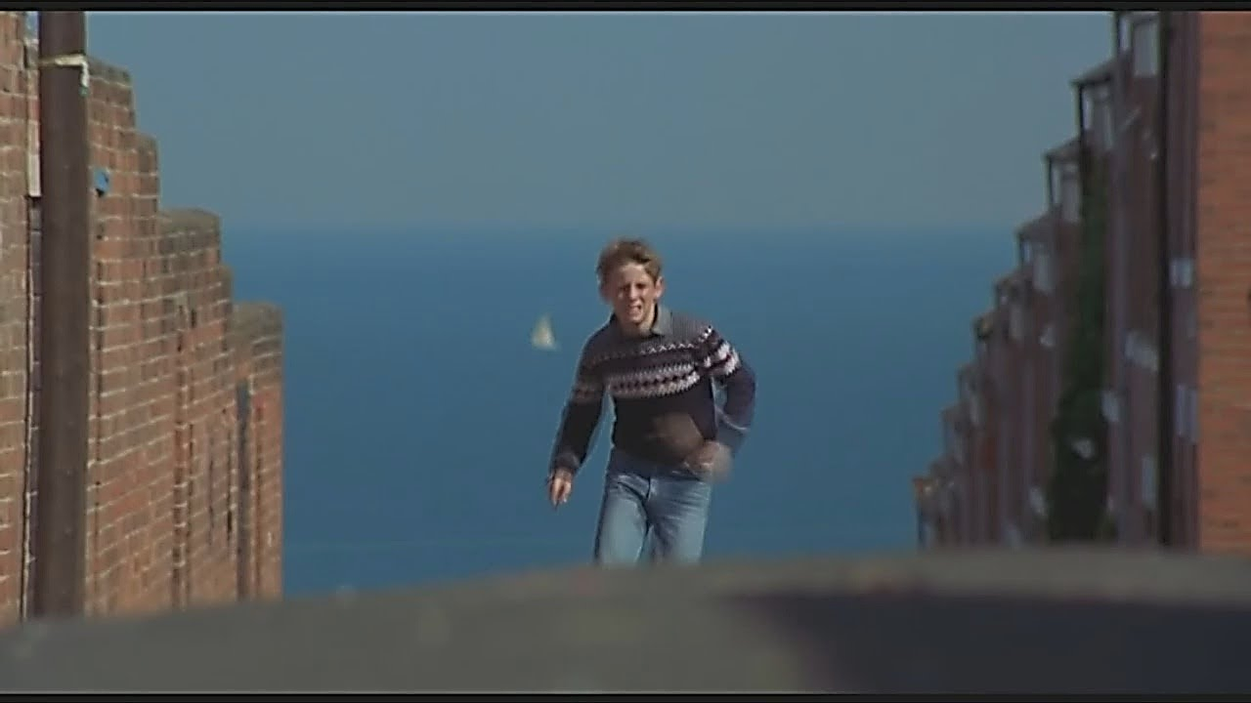
SeaScapes
Reading the Rocks
A draft story broad
4. Our industrial legacy
The film sets
The geology and physical processes that have shaped the coast provide the canvas in which we live, work and play in.
Dawdon: Alien 3 (Coal heritage)
Blackhall: Get Carter (Coal heritage)
Easington: Billy Elliot (Coastal evolution and sea-level change)

Slide 21
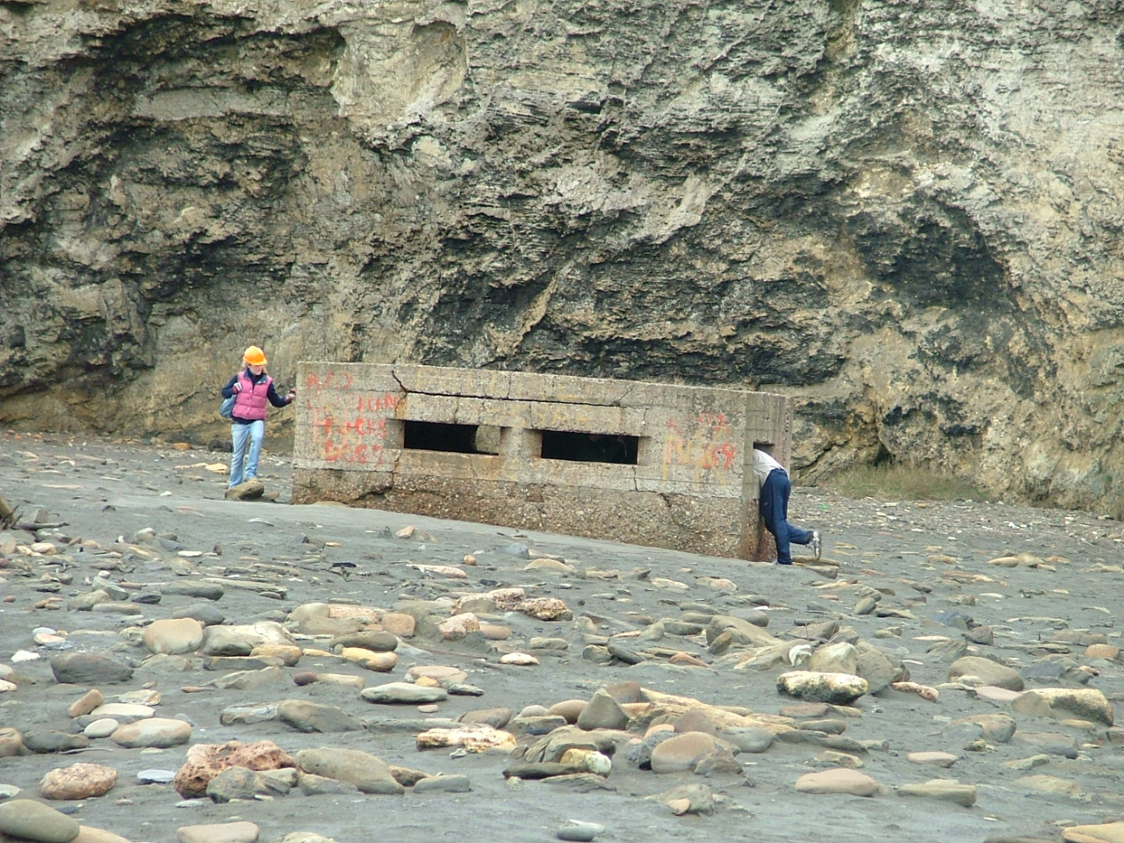
SeaScapes
Reading the Rocks
A draft story broad
5. Exploring – Reading the rocks
Key Hubs for information: Seaham
Key sites of interest
    Marsden
    Whitburn
    Seaham to Ryhope
    Blast beach
    Hawthorn Hive
    Easington/Shippersea Bay
    Warren House Gill
    Blackhall/Castle Eden Dene
    Crimdon/Hartlepool headland
    Guided Walks/Events
      TBC
David Roberts/Durham University/ March 2019

